Slide 1
GAAD Hackathon
Card Champion Project – Playback Pitch
Discover Designers

Slide 2
Why
Goal: Increase the click through to applying for a product Value: Equitable experience for our users individual needs
Benefit: Confidence in the choice of product they are choosing
75% of disabled people and their families have walked away from a UK business because of poor accessibility or customer service
73% of potential disabled customers experience barriers on more than a quarter of websites they visited
The Purple Pound – Infographic – Purple (wearepurple.org.uk)

Slide 3
Who
The user group we focused on was:
Content Consumers
Dyslexia
New to the site
Little prior experience of finance

Slide 4
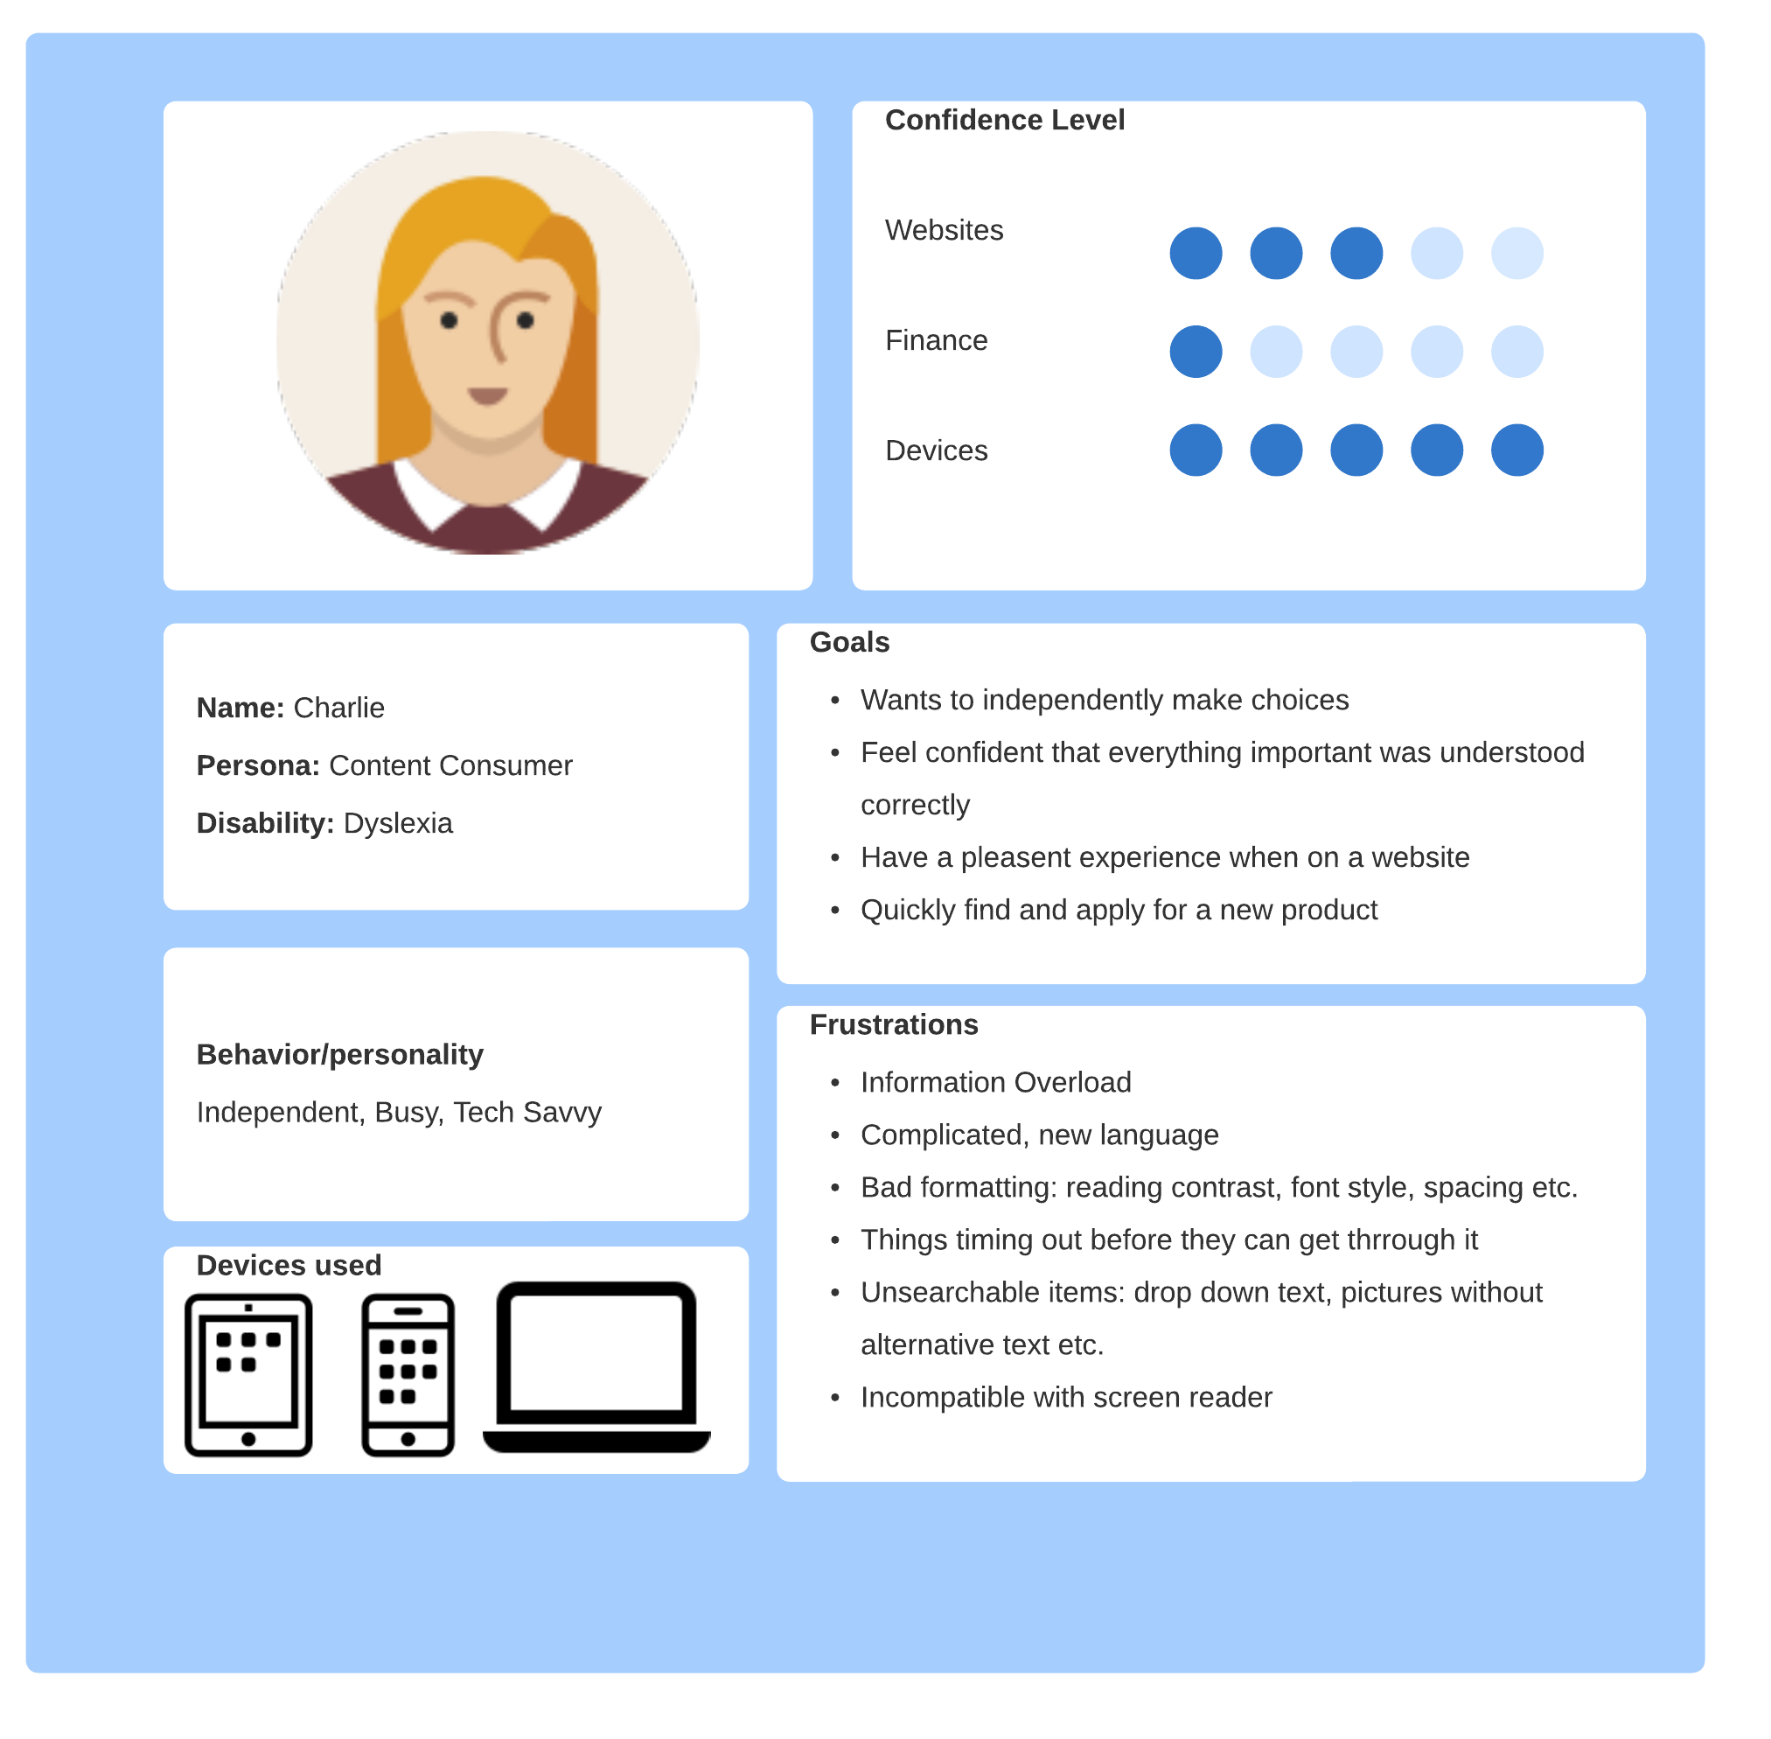

Slide 5
What
Finding and picking the product that is right for you from multiple choices of products.
Getting to the product page
Understanding the products
Comparing which is best for them
WITHOUT having a bad user experience
We chose the scenario of selecting a credit card

Slide 6
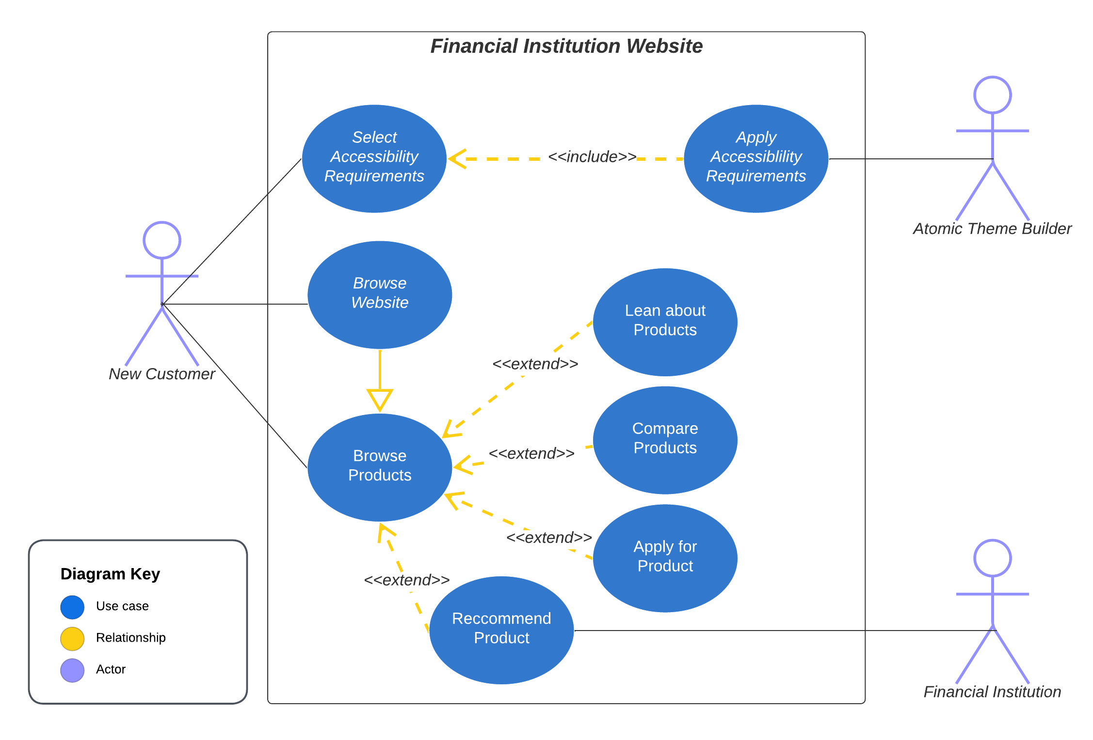

Slide 7
Where
User is accessing information on the products through:
The Financial institutions website
On their personal device
Large screened device (e.g Laptop) – Atomic Theme Builder limitation
From their home
No customer service assistance – self serving

Slide 8
When
The initial impression of the website when a user is going to pick a credit card
Accessibility Needs
Product Menu
Credit Card Page
Comparison Page
Continued consistent accessible experience afterwards (example: applying for card)

Slide 9
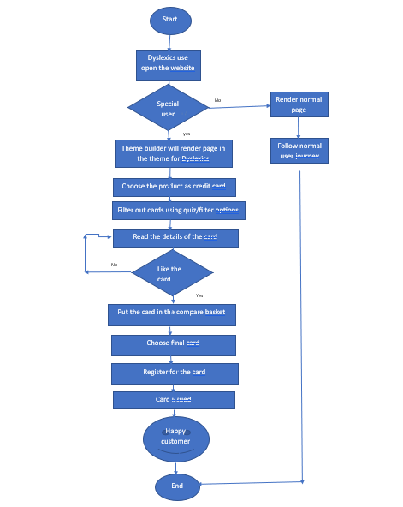

Slide 10
Wow
By implementing these changes Financial institutions are more likely to
Increase users of their products – direct and family members
Increase revenue
Have happy, confident, loyal customers
Banks or Building Societies lose £935 million per month by not being accessible
4.3 million disabled online shoppers click away from inaccessble websites – they have a combined psneding power of £11.75 billion in the UK
The Purple Pound – Infographic – Purple (wearepurple.org.uk)

